Slide 1
2020 PIUG Business Meeting
Wednesday 13 May 2020

Slide 2
Business Meeting Agenda
PIUG 2020 Annual Conference Update
Report from the PIUG Chair
PIUG Committee Reports & Updates
Questions & Comments & Discussion

Slide 3
2020 Conference
Moved to October 12-16 at Caribe Royale in Orlando
Will be a similar format but shifted
Discussing virtual options
Service awards, Kaback award, Stockdale award

Slide 4
Sponsors
Gold
Derwent
STN
Silver
BizInt Smart Charts
Bronze
Aptean GenomeQuest
CPA Global
Minesoft
Questel
Exhibitors Plus
EPO
PCT Help-Desk
Exhibitors
Ambercite

Slide 5
2020 Annual Conference Volunteers
Planning Co-Chairs –Martha Yates and Ken Koubek
Program Chair– Martha Yates
Program Committee—Shelley Pavlek and Lucy Antunes
Brian Stockdale Award Committee – Tony Trippe (Chair), Dominic DeMarco, Ken Koubek, Andrea Davis
Stu Kaback Business Impact Award Committee – Malcolm Hallam, Stephen Adams, Shelley Pavlek, Yun Yun Yang, Tony Trippe, and Elliott Linder
Evaluations – Ken Koubek (AC)
Gifts – Ken Koubek (AC)
First Time Attendee Welcome & Orientation – Suzanne Robins (Chair) and the Member Relations Committee
Meeting Book – Diane Webb
Photography – Sandra Unger
Signage – Zhifu Shu
Sponsorship & Exhibits – Jane Thompson and Ken Koubek
Travel—Ron Kaminecki
Web pages – Tom Wolff (Webmaster)
Workshops – Martha Yates

Slide 6
Save the Dates
PIUG 2021 Annual Conference
May 2-6 Westin Alexandria
PIUG 2021 Biotech Conference
Feb 23-24, Kimpton Marlowe, Boston

Slide 7
Board of Directors
Martha Yates (Chair 2018-2020)
Shelley Pavlek (Vice-Chair 2018-2020)
Malcolm Hallam (Treasurer 2018-2020)
Rosanna Lindquist (Secretary 2018-2020)
Elliott Linder (Immediate Past Chair 2018-2020)
Heather Simmons (Director at Large 2016-2020)
Ron Kaminecki (Director at Large 2018-2022)

Slide 8
New Board of Directors
Shelley Pavlek (Chair 2020-2022)
Kim Miller (Vice-Chair 2020-2022)
Malcolm Hallam (Treasurer 2020-2022)
Leah Sandvoss (Secretary 2020-2022)
Martha Yates (Immediate Past Chair 2020-2022)
Victoria Smith (Director at Large 2020-2024)
Ron Kaminecki (Director at Large 2018-2022)

Slide 9
Report from the Chair
Martha Yates

Slide 10
High Points
Thank you
Board
Committee members
Volunteers
Update PIUG website
Retire PIUG wiki

Slide 11
PIUG Functional Committees
Membership – Chair position vacant
Seth Mendelson, Acting Chair
Member Relations Committee – Suzanne Robins, Chair
Electronic Communications Committee – Chair position vacant
Tom Wolff, Acting Chair
Sponsorship Committee – Ken Koubek
Jane Thompson, past Chair
Education and Training Committee – John Zabilski, Chair
Certification Committee –Ron Kaminecki, Chair
Partnerships and Patent Offices Committee – Cynthia Barcelon-Yang and Stephen Adams, Co-Chairs
Chair position vacant for 2020
Nominating Committee—Rosie Lindquist, Carol Bachmann and Ken Koubek

Slide 12
Agenda for Committee Reports
Treasurer's Report – Malcolm Hallam
PIUG 2019 Northeast Conference Report –Shelley Pavlek
PIUG 2020 Biotech Conference Report –Alison Taylor
Membership and Member Relations Committee Report—Suzanne Robins
Certification Committee Report—Ron Kaminecki
Electronic Communications Committee Report –Tom Wolff
Partnerships and Patent Offices Committee Report—Elliott Linder
Education and Training Committee Report—John Zabilski

Slide 13
Treasurer’s Report
Malcolm Hallam
Wednesday 13 May 2020

Slide 14
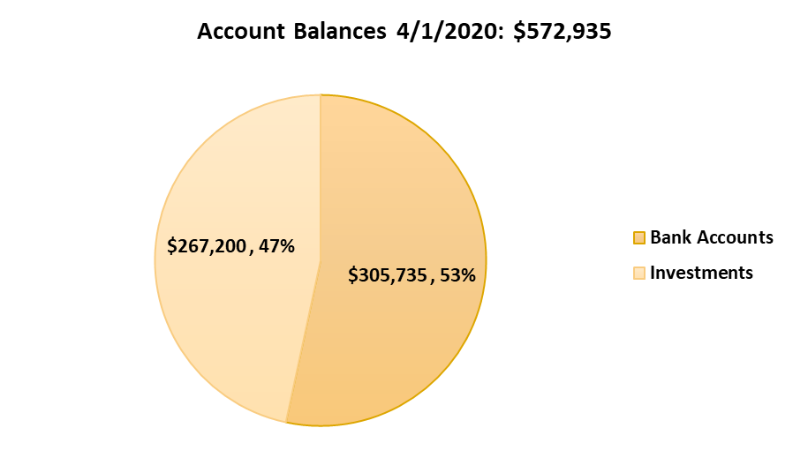
Our net worth remains robust
 | 12/31/2017 | 12/31/2018 | 12/31/2019
Net worth | $583,159 | $591,554 | $530,258

Slide 15
Financial Stewardship
Investments are moderately conservative
Cash cushion to cover wide variations in timing of income and expenses, especially around conferences
Reserves provide contingency against unforeseen economic situations
We are in good shape to weather the 2020 pandemic

Slide 16
We are making money on education offerings but now losing on conferences
Net Income | Annual Conference | Northeast Conference | Biotech Conference | Classroom Courses | Webinar Courses
2018-19 | ($954) | ($5,191) | ($1,715) | $8,529 | $3,042
2019-20 | ($61,235) | ($1,479) | $7,715 | $1,257 | $5,019
Lower attendance at all conferences
Criticality of hotel room bookings
Strong sponsor support at Biotech 2020
Course expenses include faculty share of proceeds

Slide 17
Conference Economics
Venue fees and concessions rely on hotel room uptake:
2019 Alexandria attrition penalty ~ $18,700
Registration fees contributed ~ $73,000 – about 25% of budget
Sponsors & Exhibitors contributed ~ $135,000 to the 2019 conference
2020 in Orlando – a lot still unknown

Slide 18
Treasurer Takeaways
Membership declining and attendance has been down at all of our conferences
Conference economics have become tough
Educational offerings have done well but need increased effort
DC/Alexandria location for Annual Conference doesn’t guarantee high attendance

Slide 19
PIUG 2019 Northeast Conference
September 23-25, 2019 The APA Hotel Woodbridge Iselin, NJ

Slide 20
Sponsors
Gold Sponsor
BizInt Solutions
Bronze Sponsors
CAS
aptean GenomeQuest
Minesoft, Ltd.
Questel
Silver Sponsor
STN International

Slide 21
Volunteers
Program Committee:
Shelley Pavlek (Chair), John Marlin, Yateen Pargaonkar, Leah Sandvoss, Don Walter
Planning Committee:
Chair: Shelley Pavlek
Evaluations: Shelley Pavlek
Exhibit Hall: Ken Koubek
Meeting Booklet: Diane Webb
Networking: Rick Williams
Photography: Sandra Unger
Registration: Ken Koubek, Shelley Pavlek
Signage: Hongbo Liu
Sponsorship: Ken Koubek
Webpage: Rick Williams, Tom Wolff
Workshops: Shelley Pavlek

Slide 22
Feedback
Positives:
97% said meeting was worthwhile
Strong Program (one of our strongest)
Top Presenters:
Keith Schreiber (Pfizer) – Structure Search Capabilities
Ashton Delauney (Bristol-Myers Squibb) – Sovereign Immunity
Plenty of time for questions & exhibit hall
Needs Improvement:
Need more attendees
Need more sponsors – not enough new customers to justify sponsorship cost
Conference location and venue had mixed reviews
AV needs to be improved – trouble advancing slides during the entire conference
Less presentations & more time for networking
More time for workshops; hands-on learning

Slide 23
Hiatus for 2020
PIUG Board will revisit for 2021

Slide 24
PIUG 2020 Biotechnology Conference Summary
Tuesday and Wednesday, 25-26 February, 2020
Kimpton Marlowe, Cambridge, MA

Slide 25
Highlights
Full day Plenary session with 7 speakers covering patent eligibility (keynote), sequence searching, antibody claims, and biotech IP and filings analyses.
One remote speaker from EPO
Panel session on Searcher/Practitioner collaboration
68 attendees in total
Conference made a profit of $7714.

Slide 26
Highlights
Full day Workshops session with 5 presenters
Sessions included hands-on training
Hands-on training may require a longer workshop session to accommodate effective learning
7 Exhibitors showcased new products and services
Suggestion made to allow exhibitors 2 days for booth and demo presentations.

Slide 27
Learnings & Plans for Future Conferences
Learnings
Hotel good but on-site PIUG hotel liaison person needed
Remote speaker sessions need a validated procedure
Plans for Future Conferences
West coast location
Modify publicity to attract more attendees
Investigate options for remote attendance

Slide 28
Membership and Member Relations Committee Reports
Wednesday 13 May 2020

Slide 29
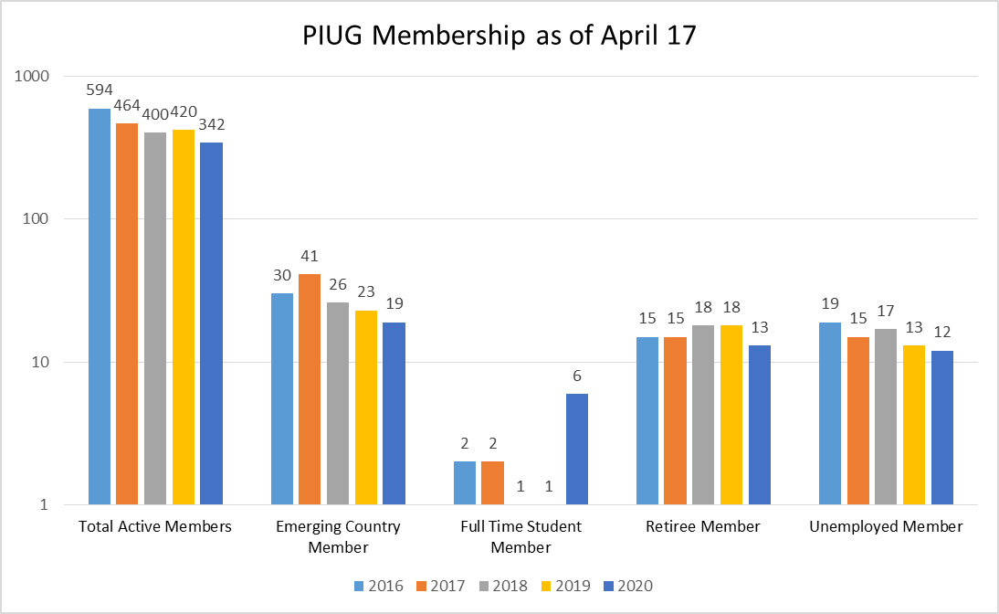

Slide 30
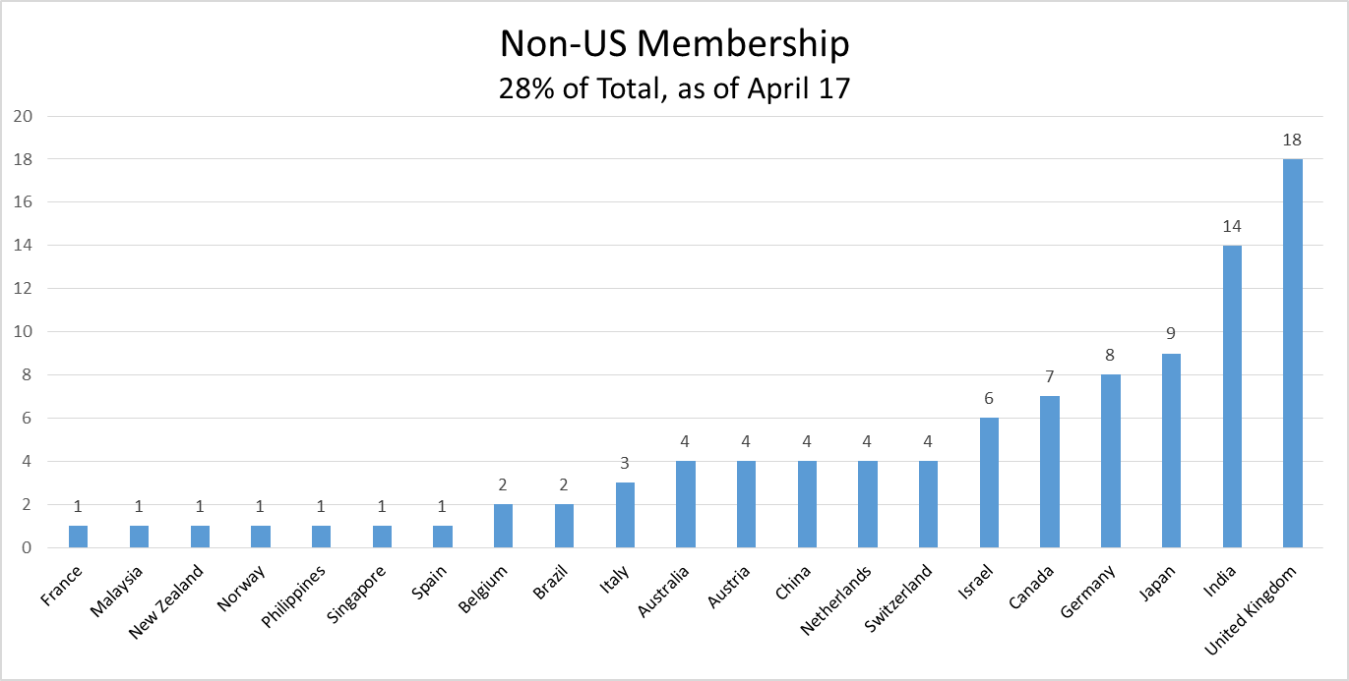

Slide 32
PIUG Member Relations Committee
Goal
To welcome new members and increase retention of current members
Activities
Committee meets monthly by teleconferences; sends personalized emails at various times throughout the year - to new and returning members, to first time conference attendees before and after the conference, to previous meeting attendees who have not registered
Notes:
32

Slide 33
PIUG Member Relations Committee
Activities (continued)
Host First Time Conference Attendee Welcome and Orientation Reception at Annual Conferences
Create Tips for First Time Conference Attendees for Website
Reach out to previous meeting attendees yet to register for a meeting.
Notes:
33

Slide 34
PIUG Member Relations Committee
Committee Members - * Are volunteers sending emails to members
Suzanne Robins (Chair)
Malcolm Hallam* (International Member Liaison Officer and Board Liaison)
Cathy Chiba*
Seth Mendelson*
Kartar Arora*
Heidi Stone*
Wongel Tefera*
Barbara Miller*
Cedric Tchakounte*
Heather Simmons
Gus Pinto
A.J. D'Ambra
Ken Koubek
Tom Wolff
Elliott Linder
Kris Atkinson
Barbara Hampton

Slide 35
Certification
Wednesday 13 May 2020

Slide 36
Certification
PIUG members involved in certification:
Susanne Hantos, (Vice Chair) Supervisory Committee; Examination Committee
Andrea Davis, (Chair) Qualifications & Continued Professional Development Committee
Ron Kaminecki, Professional Representatives Collegium; Examination Committee
Julia Heinrich, Examination Committee
Tony Trippe; Examination Committee
Barbara Miller, Accreditation Committee

Slide 37
Certification
Bettina de Jong, Professional Representatives Collegium (Chair); ISBQPIP Chair
David Borel, Professional Representatives Collegium (Switzerland)
Stephen Adams, BPIP (UK), Professional Representatives Collegium
Bernd Wolter, Professional Representatives Collegium (Secretary); Examination Committee;
Aalt van de Kuilen, Accreditation Committee

Slide 38
Certification
Professional Experience Recognition (PER)
262 certificates out of 280 applicants
Germany 46
US 32
Netherlands 31
UK 30
Switzerland 27
Italy 20…

Slide 39
Certification
Next exam in preparation
Search paper
Analysis paper
Continued Professional Development
Five points (activities) last year
Ten points per year now

Slide 40
Partnerships & Patent Offices (PPO) Committee
Wednesday 13 May 2020
Elliott Linder

Slide 41
PPO Committee Members
Stephen Adams (ex co-chair)
Cynthia Barcelon-Yang (ex co-chair)
Andrea Davis
Cynthia Gallagher
Susanne Hantos
Elliott Linder
Edlyn Simmons
Alison Taylor
Wongel Tefera

Slide 42
WANTED PPO Committee Chair or Co-Chairs
PIUG extends its gratitude to Cynthia Barcelon-Yang and Stephen Adams for co-chairing the PPO Committee since its inception in 2016. With Cynthia’s recent retirement and Stephen’s scaled-back schedule, PIUG is seeking volunteers to chair or co-chair the PPO Committee. If you are interested in volunteering, please contact Shelley Pavlek, Martha Yates, or Elliott Linder.

Slide 43
Recent and Upcoming Activity
USPTO
Presented at 2019 Northeast Conference and 2020 Biotech Conference; scheduled to present at 2020 Annual Conference
EPO
Presented at 2020 Biotech Conference; scheduled to present and be an exhibitor at 2020 Annual Conference

Slide 44
Recent and Upcoming Activity
WIPO
Stephen Adams attended the Committee on WIPO Standards (CWS) in Geneva in July 2019
Scheduled to present at 2020 Annual Conference
WIPO INSPIRE (ex-Intellogist)
Unfortunately, the new database is lacking the narrative, comparative content that made Intellogist so valuable.
WIPO needs input from providers and PIUG volunteers to develop, maintain, and review timely content. We need a PIUG volunteer to champion this initiative.

Slide 45
Recent and Upcoming Activity
WIPO
Patent Register Portal
The PIUG Patent Register Cheat Sheet project (Cynthia Barcelon-Yang, Cynthia Gallagher, Elliott Linder, Wongel Tefera) was abandoned as an independent effort in favor of cooperating with, rather than duplicating, WIPO and EPO projects, including also the EPO Patent Register and the Federated Register (covering post-grant national-phase actions).

Slide 46
Recent and Upcoming Activity
KIPO
PCT Korea Help-desk plans to be an exhibitor at 2020 Annual Conference

Slide 47
Recent and Upcoming Activity
Asia-Pacific Conferences/Relations
PIUG members conducted sessions and made presentations at the Chinese Intellectual Property Annual Conference (CIPAC) in 2016-2018 and at the Japan Patent Information Fair & Conference (PIFC) in 2017. Unfortunately, PIUG did not realize the benefits that we were hoping for, i.e., increased Asian membership and participation.

Slide 48
Recent and Upcoming Activity
Asia-Pacific Conferences/Relations (cont’d)
Therefore the PIUG Board of Directors decided to cease financially supporting these events.
The PPO Committee and the Board recognize the value of cultivating the relationship between PIUG and our Asian colleagues. PPO Committee members have put forth several suggestions for consideration by the newly-elected PIUG Board.

Slide 49
Recent and Upcoming Activity
Asia-Pacific Conferences/Relations (cont’d)
These suggestions include:
Online participation at Asian events, if available
Asian-language landing and benefits pages on the PIUG website
Japanese, Korean, Mandarin
Dedicated Asian-language pages, where curated, translated “nuggets” from PIUG conference presentations could be posted by native speakers

Slide 50
Recent and Upcoming Activity
Asia-Pacific Conferences/Relations (cont’d)
These suggestions include:
Asian-language calls for abstracts for PIUG conferences
Asian-language monitored website forum where PIUG Asian members can reply to questions from Asian colleagues

Slide 51
Recent and Upcoming Activity
ACS
PIUG co-sponsored a symposium at the ACS Fall 2019 National Meeting in San Diego in August. Entitled “Nothing New Under the Sun: The Practical Challenges of Patent Novelty Searching”, the session was part of the Chemical Information Division (CINF) program, and was also co-sponsored by the division of Chemistry and the Law (CHAL) and the Committee on Patents and Related Matters (CPRM). Edlyn Simmons and Stephen Adams were co-organizers. In Edlyn’s absence, Stephen chaired the session.

Slide 52
Recent and Upcoming Activity
PDG
Andrea Davis represented PIUG as an observer at the April 2019 PDG Impact meeting.
Stephen Adams attended the October 2019 meeting at Agfa in Antwerp.
The 2020 Impact meeting has been postponed from April until at least the autumn due to the pandemic. If Andrea is still living in Europe she will likely attend.

Slide 53
Reconfigured PIUG Web Media Electronic Communications Committee
Wednesday 13 May 2020

Slide 54
WANTED Electronic Communications Committee Chair or Co-Chairs
PIUG extends its gratitude to Tom Wolff for chairing the Electronic Communications Committee for many years. Tom has wanted to scale back his leadership in this area, thus PIUG is seeking volunteers to chair or co-chair the ECC Committee. If you are interested in volunteering, please contact Shelley Pavlek, Martha Yates, or Tom Wolff.

Slide 55
PIUG Website and Wiki
PIUG website
PIUG Board hired a Wild Apricot Expert to develop a new design
Improved access, one login account = one sign-on
Enhanced appeal
All active web content including forums, registration, dues
PIUG wiki
Eliminate active use of the PIUG wiki
Retain for archival purposes only

Slide 56
PIUG Website Updated
All critical features on the website
Eliminates delays and inconvenience of maintaining wiki accounts or multiple PIUG web accounts
Improved and simplified menu system
Reworked home page
Photos to create more interest in activities
Upcoming Events
Quick Links
Recent Forum postings
Mission and “Why Join PIUG”
Sponsors and Partners

Slide 57
PIUG Website – Forums
PIUG Public Discussion Forum (PIUG-PF)
PIUG Job Postings Forum
2020 Biotechnology Conference Committee Forum
2020 Annual Conference Planning Committee Forum
Member Relations Committee Forum

Slide 58
PIUG Website – “About PIUG”
PIUG - Internet Disclaimer & Copyright Notice
PIUG Antitrust Policy
PIUG Bylaws
History of PIUG including Brief History, and Bibliography
PIUG Milestones
PIUG Officers and Directors (Past and current)
PIUG History - A Collection of Remembrances.

Slide 59
PIUG Website Covers All PIUG Conferences
Conference information copied from the wiki
44 Conferences from 2006-2019
72 total conference session days
1150 total Plenary presentation pdf documents
All conference books, all PIUG sponsored workshop pdf documents, and review articles for Biotech Conferences

Slide 60
Possible Content to Copy from the PIUG Wiki to Website
Updating and editing would be needed
How PIUG Works
PIUG Committees and Teams
How to Become a Patent Information Professional
Patent Information Bibliography
Books Articles Other references Top Ten Publications by Stephen Adams Top Ten Publications by Edlyn Simmons

Slide 61
Archival PIUG Wiki
Some content either cannot be moved or would need major effort and maintenance
7 Discussion Forums
Knowledge Pages and subpages
Patent Resources and many subpages
Patent Information Meetings, Conferences, and Seminars
Training Opportunities (onsite workshops and courses) and subpages

Slide 62
Education and Training Committee John Zabilski, Chair

Slide 63
Education & Training 2019 Tasks
Annual Meeting Training - May 4, 2019
Introduction to Patent Searching
Patent Searching Fundamentals
Analytics Webinar Series
Recorded on-demand analytics training session
PIUG Website Education Page
https://www.piug.org/education

Slide 64
Education & Training 2020 Goals
Create PIUG Training Library
Create introductory sessions
promoted to the current membership
open to the public for attracting new members
For PIUG Members
Catalog PIUG presentations from past meetings
Invite past presenters to record live versions of their PIUG presentations for on-demand training
Advanced training webinars for everyone

Slide 65
Other discussion topics
How do we retain and attract members?
How do we retain and attract sponsors?
Future of annual conference
Length
Mixture of in person and virtual?

